Slide 1
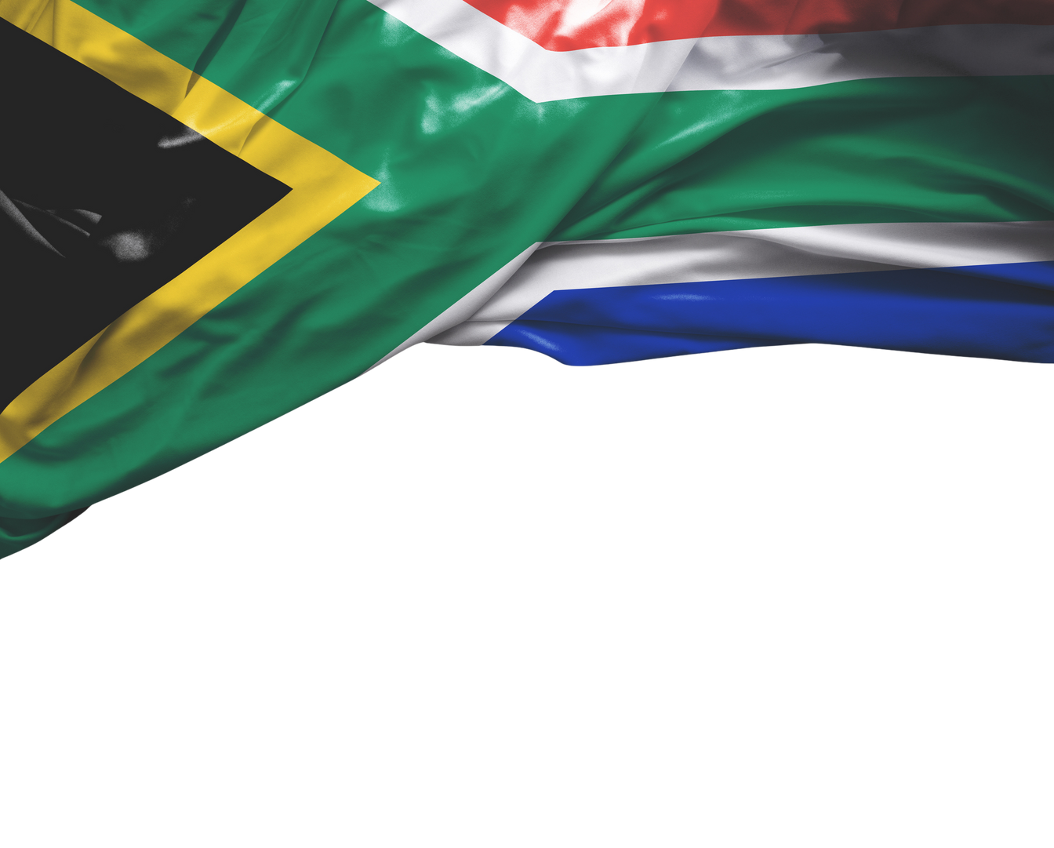

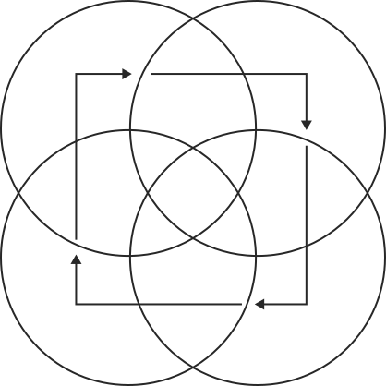
UNEMPLOYMENT ANALYSIS IN SOUTH AFRICA
Key Predictors, Trends & Insights

Slide 2
Table of Contents
1
Project Statement
2
Project Objectives
3
Visuals
4
Model Used
5
Key Insights
6
Recommendations
7
Meet Our Team

Slide 3
Problem Statement
Despite expectations that higher education levels and better school quintiles reduce unemployment, South Africa continues to experience high unemployment rates particularly among Degree and Diploma holders.
Additionally, unemployment patterns vary by gender, province, and urban-rural location, highlighting a mismatch between educational attainment and labor market absorption.

Slide 4



Project Objectives
Insights and Recommendations
Identification Phase
Analyzing
Identifying the key predictors of unemployment status in South Africa.
Analyze the impact of demographic, educational and geographical predictors of unemployment.
Provide actionable insights using machine learning and providing data driven recommendations.

Slide 5
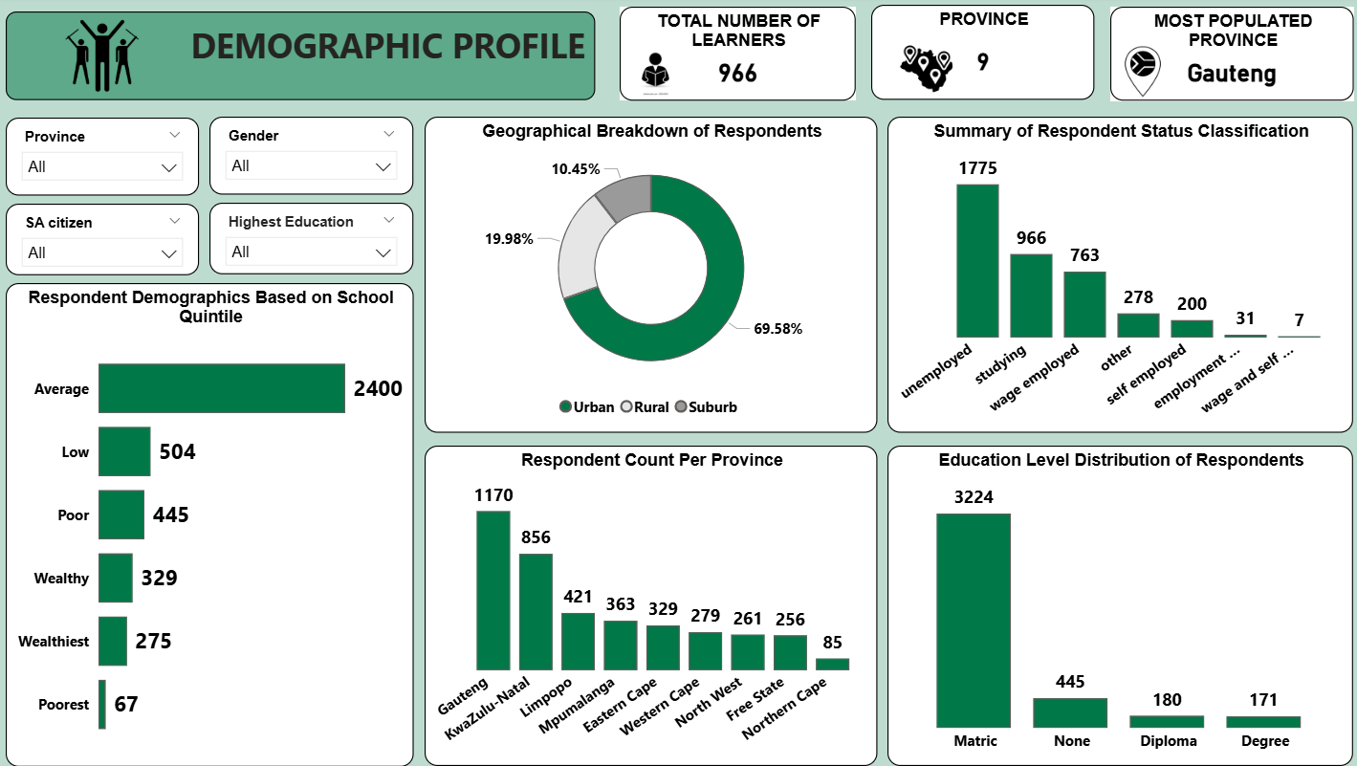

Slide 6
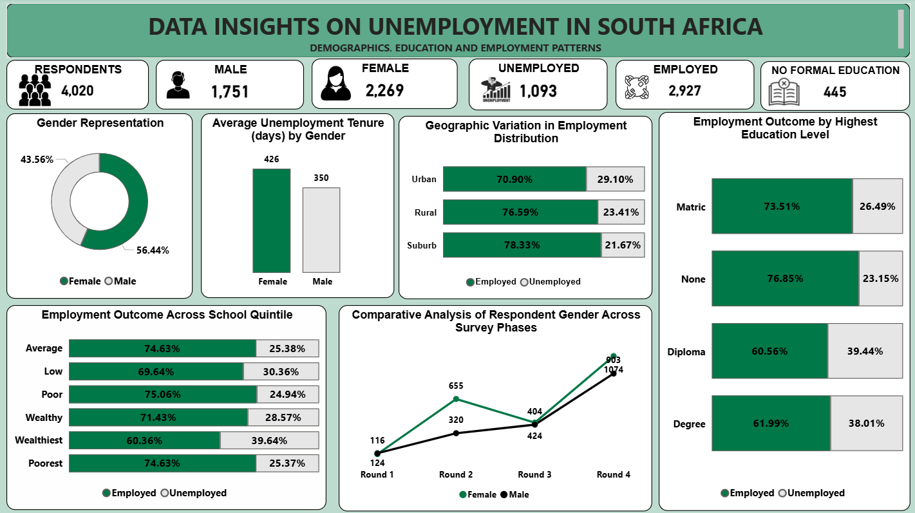

Slide 7

INSIGHTS
Males (32.44%) face higher unemployment than females (23.14%)
Degree(38.01%) and Diploma (39.44%) holders have highest Unemployment by Qualifications
Higher quintiles not linked to lower unemployment.
Gauteng (347) and KwaZulu-Natal (226) lead in unemployment figures.
Majority of respondents are urban, highlighting urban-centered unemployment.

Slide 8

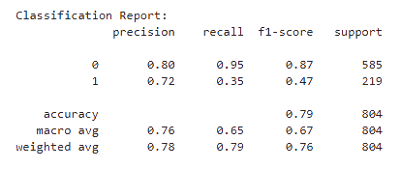

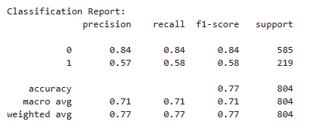
PREDICTING OUTCOMES
01
LOGISTIC
REGRESSION
02
DECISION
TREE

Slide 9
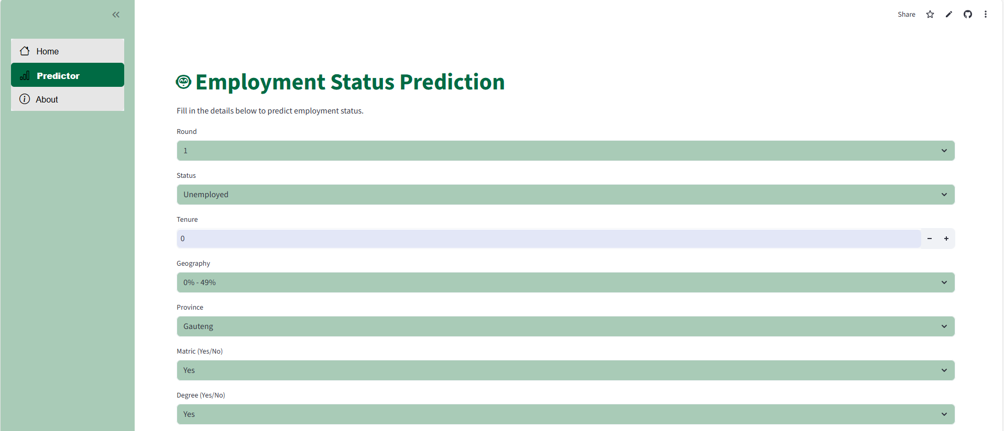
MODEL DEPLOYMENT
https://python-capstone-group-project-z8o2hqqqbmjtreghgeyehb.streamlit.app/

Slide 10

RECOMENDATIONS
Strengthen Career Readiness and Align school curricula with industry needs boost job placement & entrepreneurship support.
Upskill & Re-certify Target high-demand sectors (IT, healthcare, renewable energy)
Expand training in male related sectors like construction , technical trades and others
Diversify rural industries to reduce dependence on limited sectors.
Prioritize Gauteng & KwaZulu-Natal with job fairs and business grants.
01
02
03
04
05

Slide 11
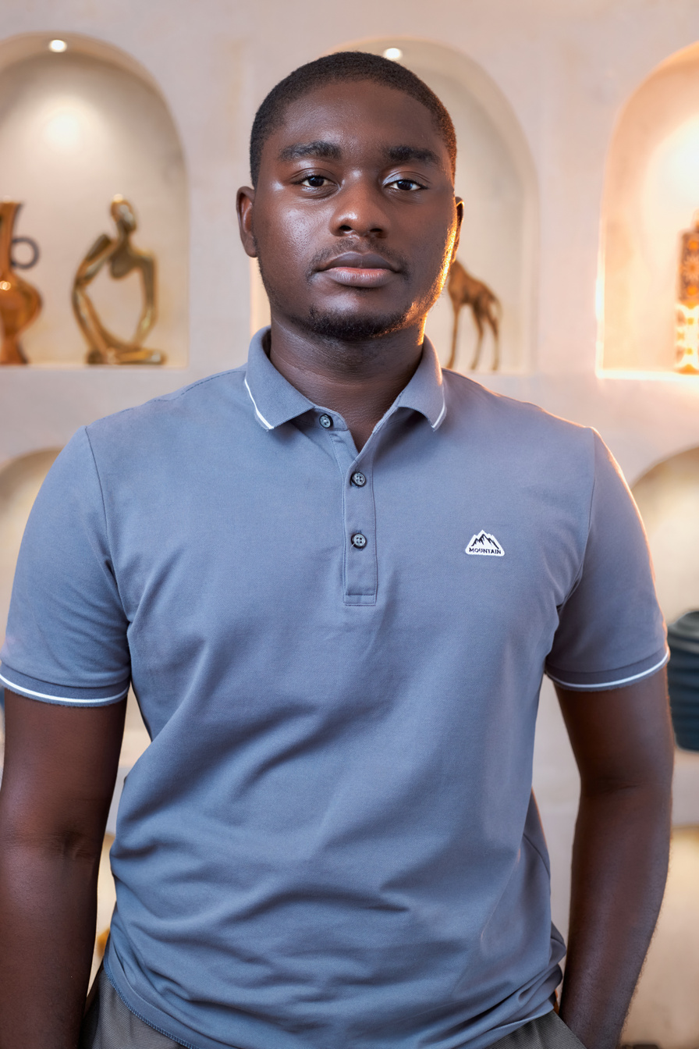
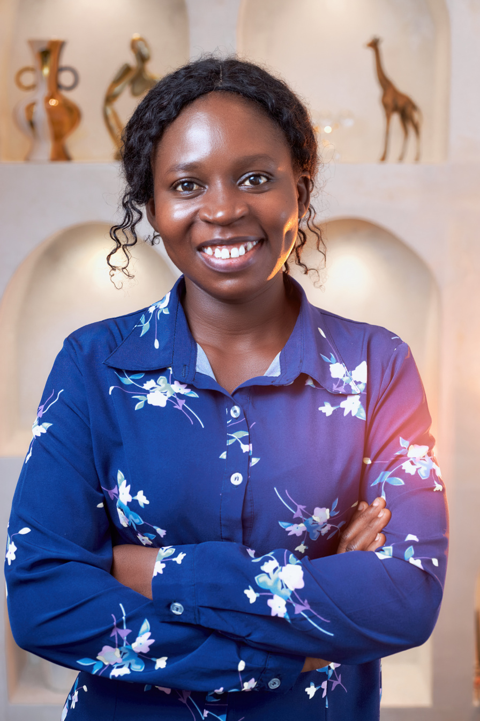
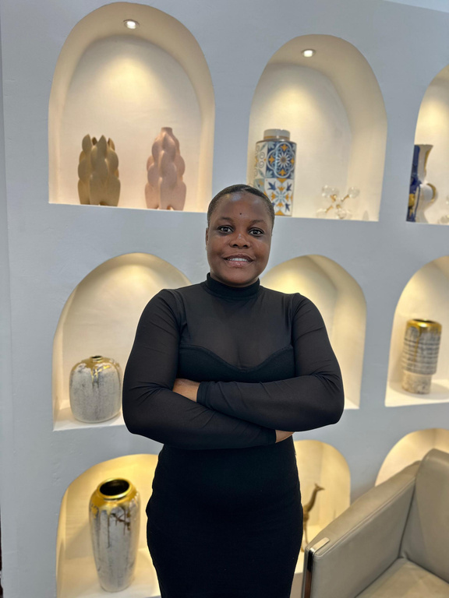
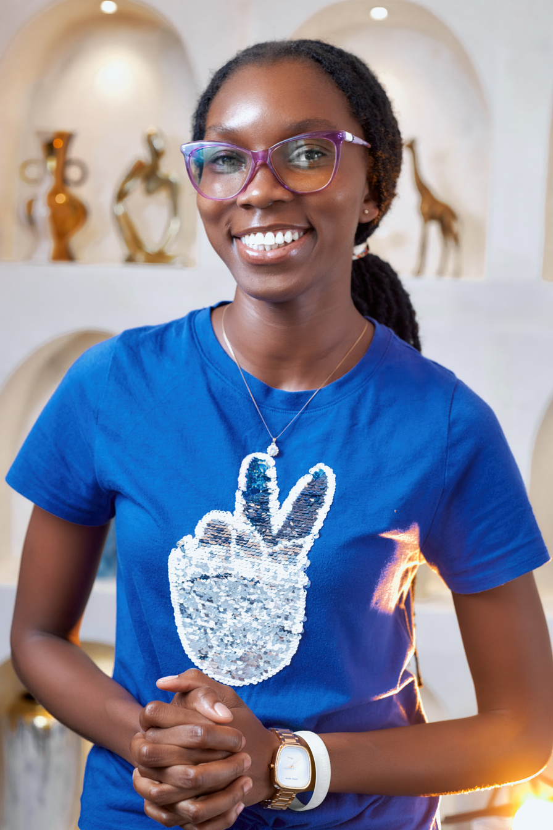
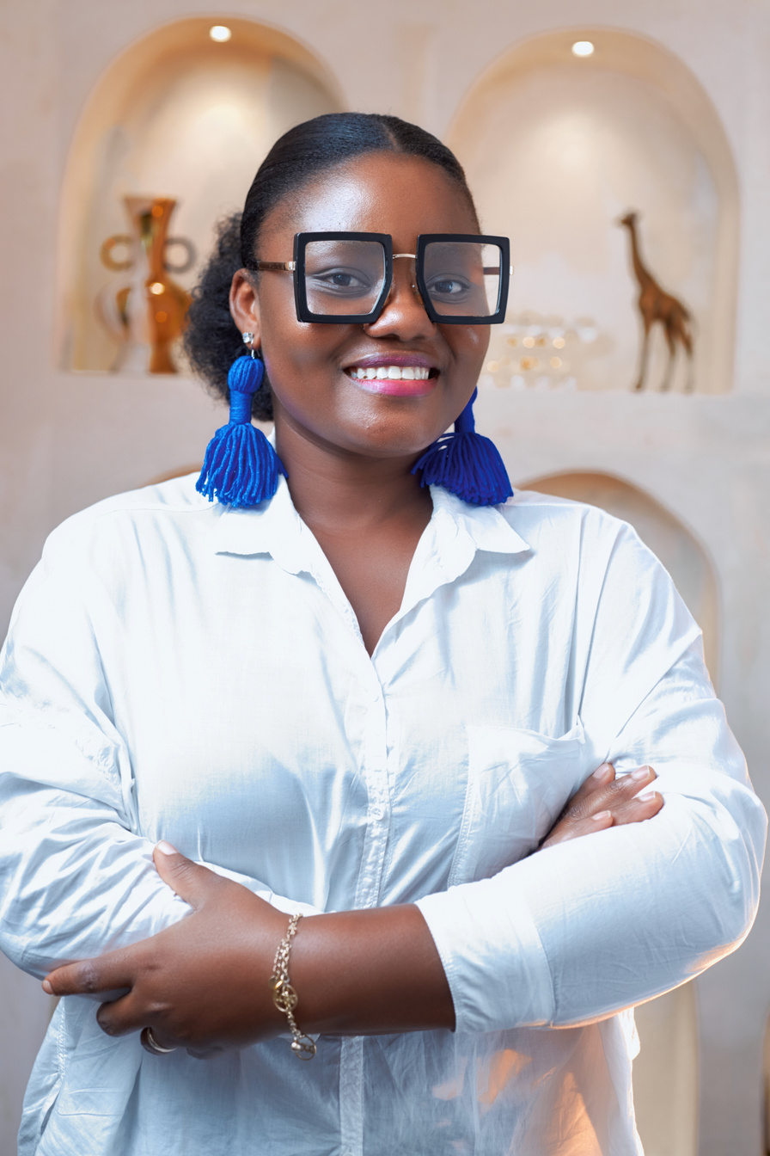
TEAM MEMBERS
Stacyln Aryee
John Antwi-Nuamah Jr
Prudence Mensah
Caroline Okraku
Clementina Klomey

